Slide 1


Boston's Ride-Share Market
Report:
Customer Behavior & Competitive Analysis
Data sourced from Kaggle.

Slide 2
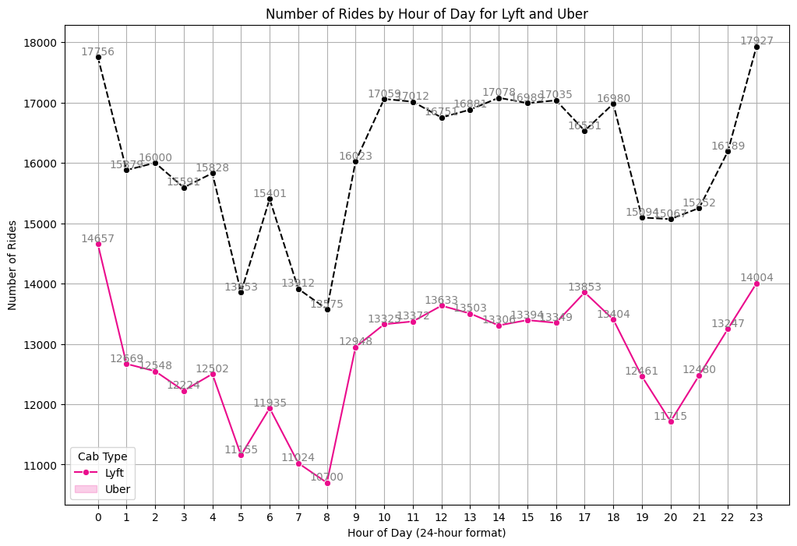
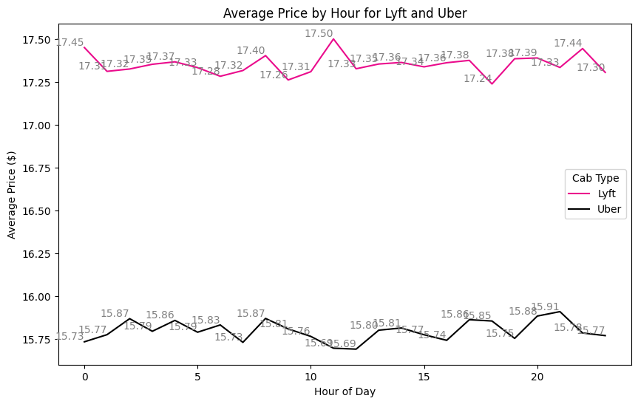
Peak Hour Demand & Pricing Trends
Notes:
Peak Hours:
Demand: Uber has the highest number of rides at midnight (17,756) and 11 PM (17,927). Lyft peaks at midnight (14,657) and 11 PM (14,004).
Strategy: Implementing targeted promotions and increasing drivers availability during these peak times to boost ridership further.
Pricing Strategy:
Average Prices: Lyft's average ride price is about $17.30 to $17.50, whereas Uber's is $15.70 to $15.91.
Recommendation: Lyft should review its off-peak pricing to remain competitive. Uber can leverage its lower prices to attract price-sensitive customers.

Slide 3
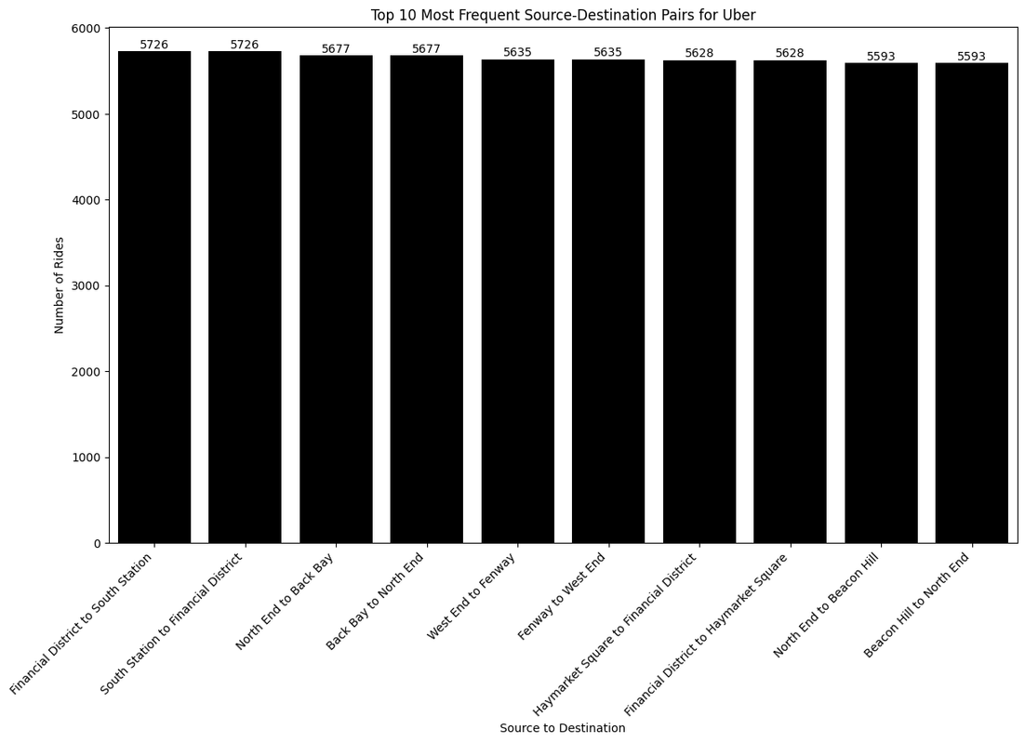
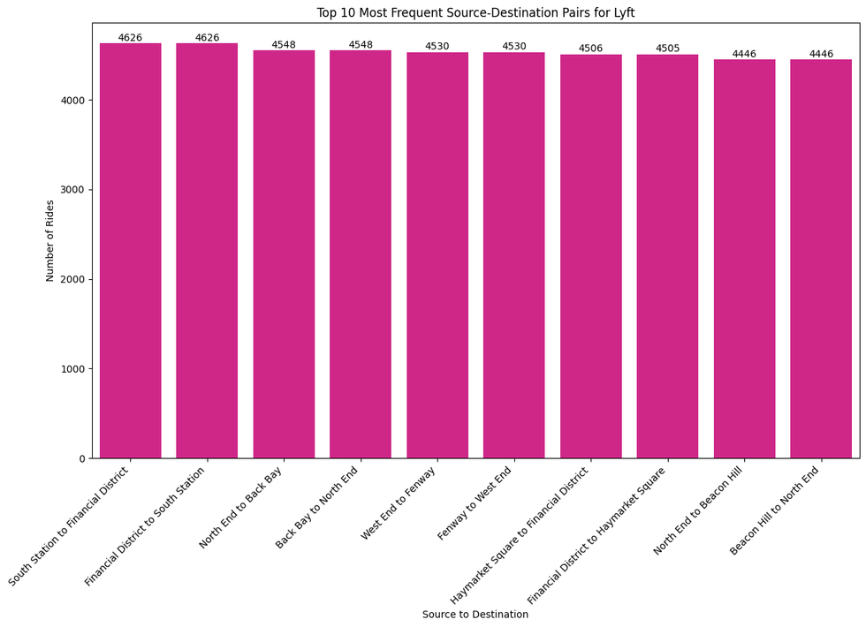
Optimizing Ride-Sharing: Key Routes
Notes:
Top Routes:
Lyft: South Station to Financial District (4,626 rides), Financial District to South Station (4,626 rides)
Uber: Financial District to South Station (5,726 rides), South Station to Financial District (5,726 rides)
Recommendations:
Promotions: Targeting top routes to attract riders
Driver Allocation: Ensuring availability on popular routes
Targeted Marketing: Focusing on working professionals commuting to major hubs like South Station and the Financial District
The majority of these destinations are connected to commuter rail stations (like South Station) or the Financial District, where many top companies are located. This indicates a significant opportunity to target customers who are working professionals. By understanding and leveraging these commuter patterns, both Lyft and Uber can implement strategies to attract and retain this key customer segment.

Slide 4
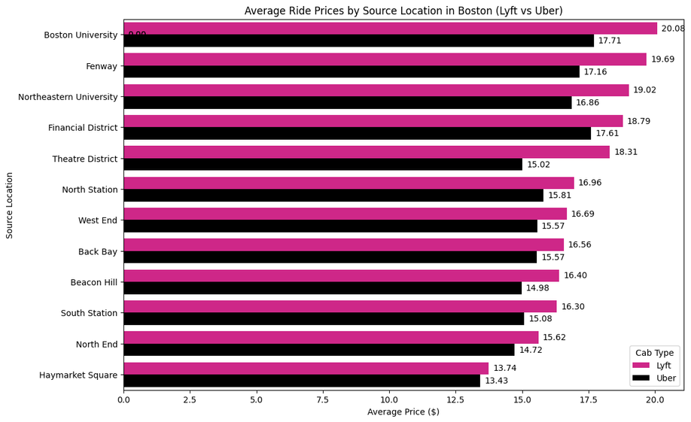
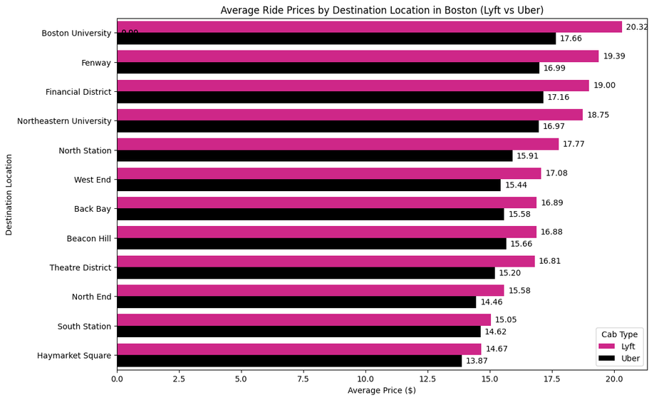
Key Insights & Recommendations
High-Demand Locations:
Target marketing and ensure driver availability at Boston University, Fenway, Northeastern University, and the Financial District.
Pricing Comparison:
Lyft reviews higher pricing; Uber attracts price-sensitive customers with lower prices.
Targeted Marketing:
Focusing on students and professionals in high-demand areas like Boston University and the Financial District.
Driver Allocation:
Optimizing driver shifts to cover peak times and key locations, improving service reliability and customer satisfaction.
Student Discounts:
Providing vouchers or discounts to students in major locations to attract and retain them and increase CLV.

Slide 5
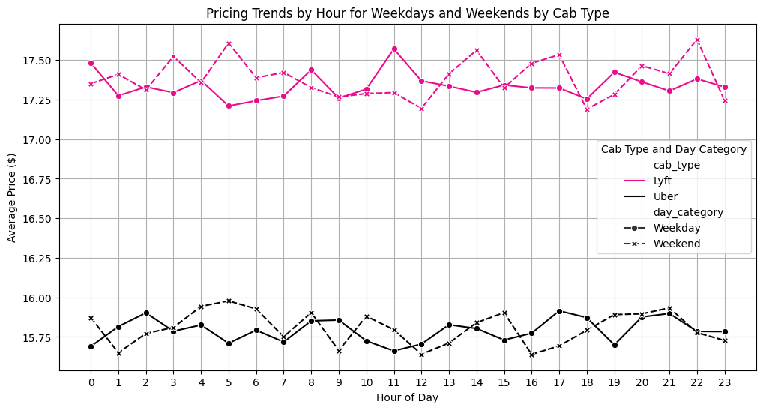
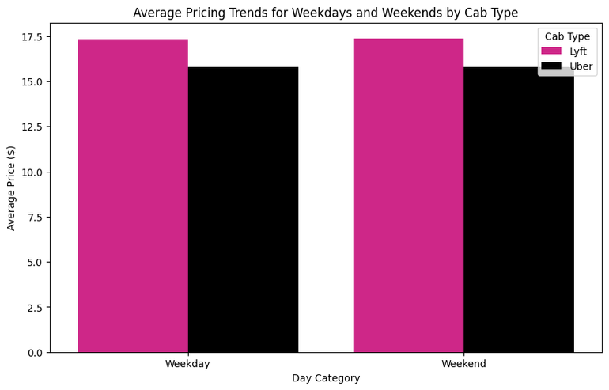
Weekday vs Weekend Pricing Trends
Notes:
Analysis and Insights
Average Pricing Trends for Weekdays and Weekends:
Observation:
Lyft's average price is approximately $17.50 on both weekdays and weekends.
Uber's average price is approximately $15.75 on weekdays and $16.00 on weekends.
Insight:
Lyft maintains a consistent pricing strategy across weekdays and weekends.
Uber's prices slightly increase during the weekends, possibly reflecting higher demand.
Pricing Trends by Hour for Weekdays and Weekends:
Observation:
Lyft's hourly prices fluctuate slightly but remain around $17.25 to $17.50 for both weekdays and weekends.
Uber's hourly prices show minor fluctuations, with a range of $15.50 to $16.00, slightly higher on weekends.
Insight:
Both Lyft and Uber exhibit stable pricing throughout the day, with Lyft maintaining higher overall prices.
Uber's pricing increase during weekends suggests a dynamic pricing model responsive to higher demand periods.
Recommendations
Lyft:
Maintaining the consistent pricing strategy while exploring promotional offers during specific hours to boost ridership.
Considering dynamic pricing adjustments to maximize revenue during peak demand hours on weekends.

Slide 6
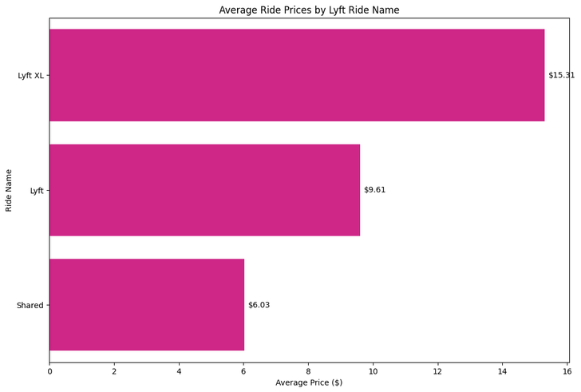
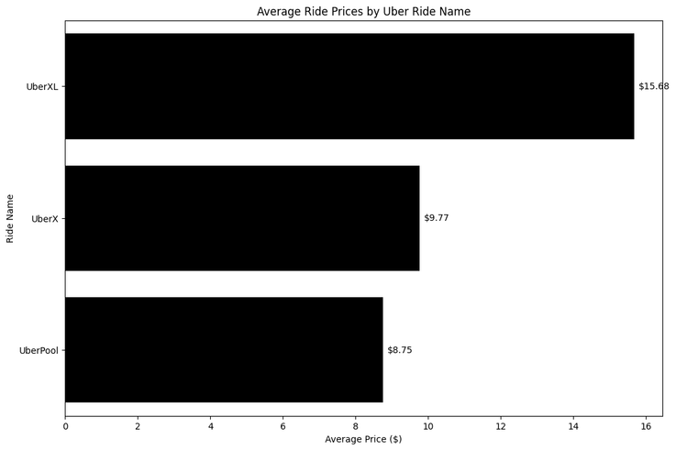
Average Ride Prices by Ride Type
Comparative Insights
Premium Rides:
Both Lyft XL and UberXL are priced similarly, indicating that both companies charge a premium for larger, more spacious rides.
Standard Rides:
UberX is slightly more expensive than Lyft, suggesting Uber may be targeting a slightly higher price point for standard rides.
Shared Rides:
Lyft's Shared rides are cheaper than UberPool, potentially giving Lyft a competitive edge in attracting cost-sensitive customers.
Notes:
Analysis and Insights
Lyft
Average Prices:
Lyft XL: $15.31
Lyft: $9.61
Shared: $6.03
Insights:
Lyft XL is the most expensive ride type, indicating a premium service for larger groups or more spacious rides.
The standard Lyft ride is moderately priced.
Shared rides are the most affordable option, appealing to cost-conscious customers.
Uber
Average Prices:
UberXL: $15.68
UberX: $9.77
UberPool: $8.75
Insights:
UberXL is the most expensive ride type, similar to Lyft XL, offering a premium service for larger groups.
The standard UberX ride is slightly more expensive than the standard Lyft ride.
UberPool is an affordable option, though slightly more expensive than Lyft's Shared rides.

Slide 7
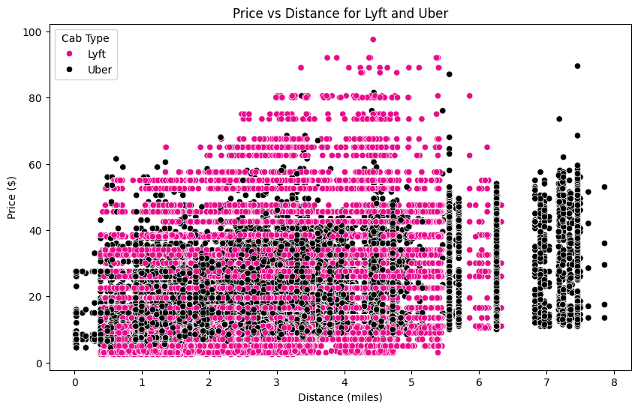
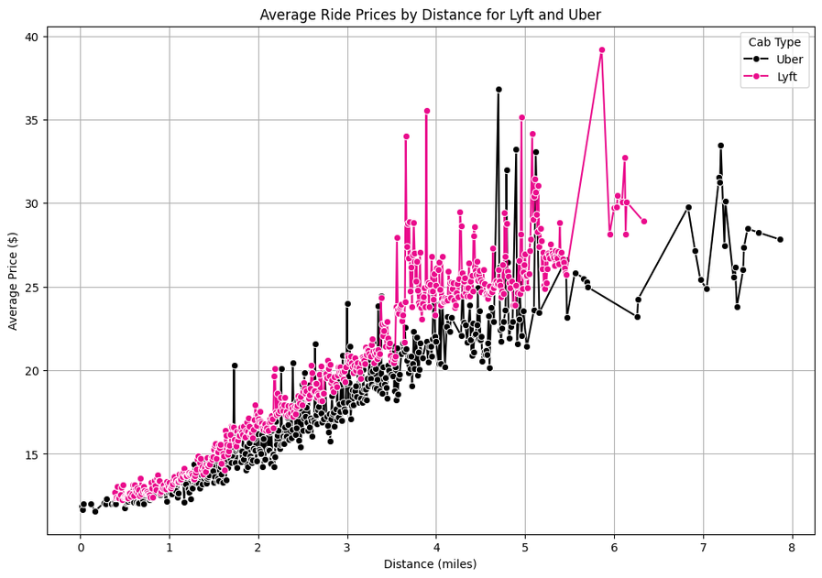
Add your text
Price vs Distance Analysis
Insights:
Both ride-sharing services exhibit variability in pricing, possibly influenced by factors like time of day, demand, and surge pricing.
Lyft's greater variability and higher price spikes suggests a more dynamic pricing model, potentially offering opportunities for targeted discounts or promotions.
Uber's more stable pricing trend may appeal to customers seeking predictability in fare costs.
Add more text
Notes:
Analysis and Insights
Left Chart: Average Pricing Trends for Temperature Categories by Cab Type
Observation:
Both Lyft and Uber only have pricing data for the "Freezing" temperature category.
Lyft's average price in freezing temperatures is approximately $17.50.
Uber's average price in freezing temperatures is approximately $16.00.
Insight:
Both services have higher average prices during freezing temperatures, potentially due to increased demand and challenging driving conditions.
Right Chart: Distribution of Prices by Temperature Category and Cab Type
Observation:
The box plot shows the distribution of prices for Lyft and Uber in freezing temperatures.
Lyft's price range is wider, with prices ranging from approximately $10 to $40, with several outliers reaching up to $100.
Uber's prices are more concentrated, with a range from approximately $10 to $35, also showing outliers up to $100.
Insight:
Lyft exhibits a wider variability in pricing, indicating a more dynamic pricing model that may be influenced by various factors.
Uber's pricing, while also variable, is more concentrated, suggesting a slightly more stable pricing approach in extreme weather conditions

Slide 8
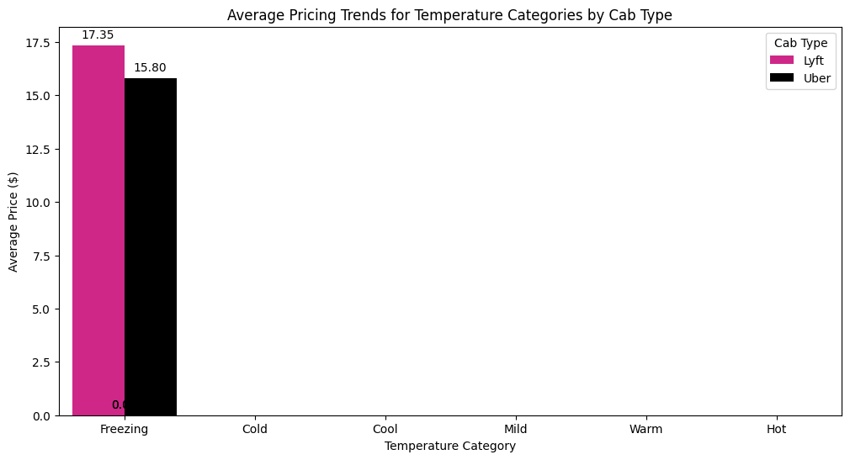
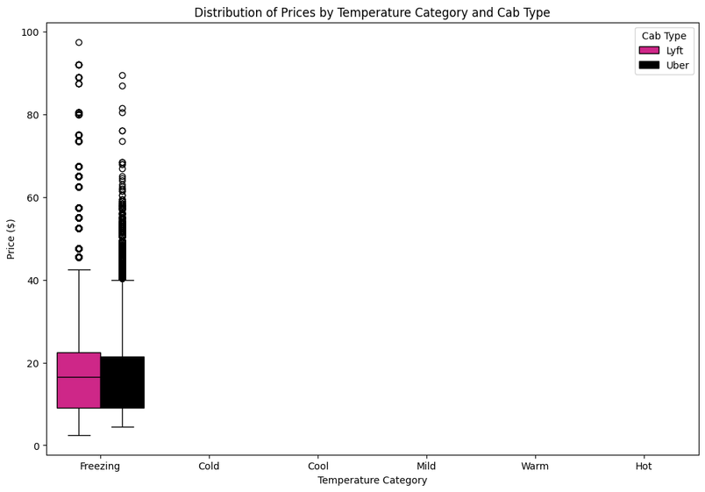
Impact of Temperature on Ride Prices

